Slide 1


Slide 2




Slide 3
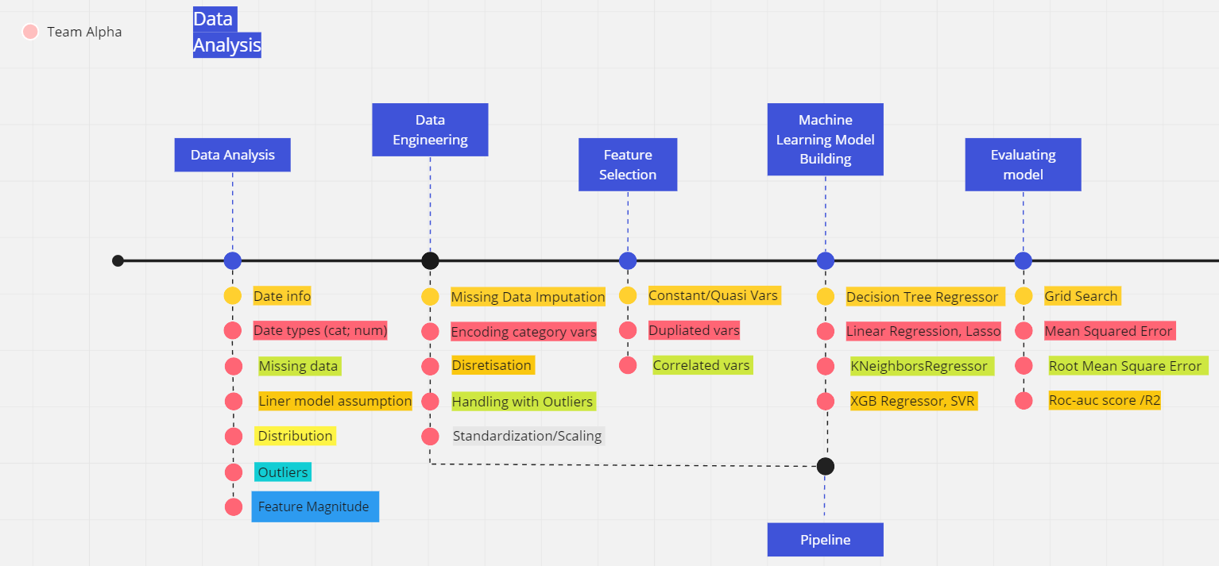
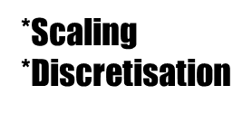
DATE PROCESSING

Slide 4
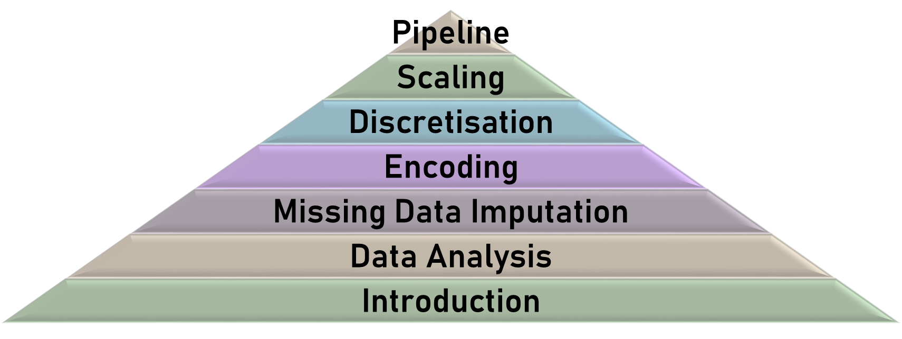
PROJECT COMPOSITION

Slide 5
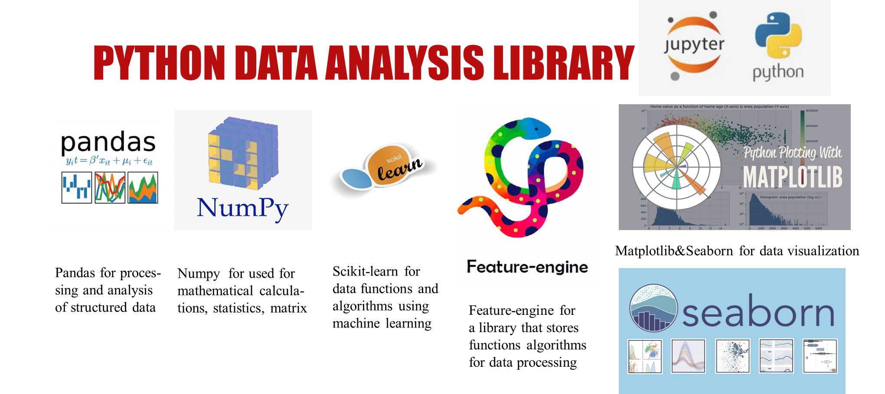

Slide 6

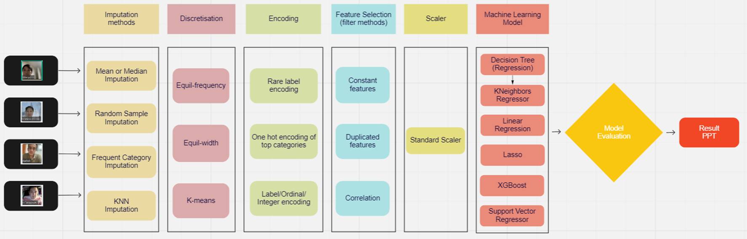
MIRO FOR STRATEGY PROJECT

Slide 7


Slide 8
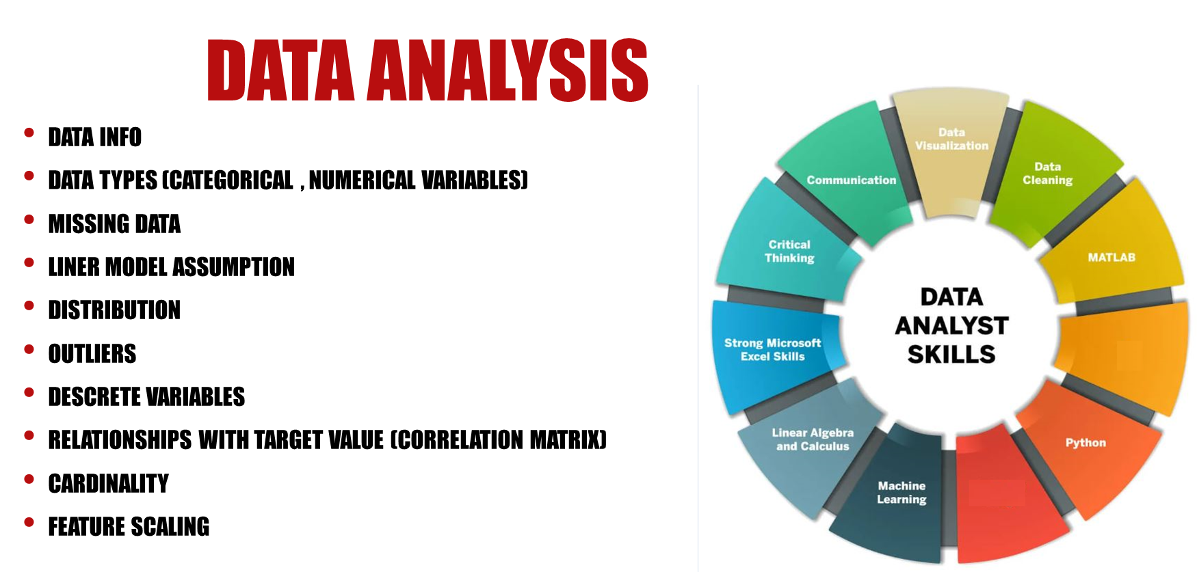

Slide 9

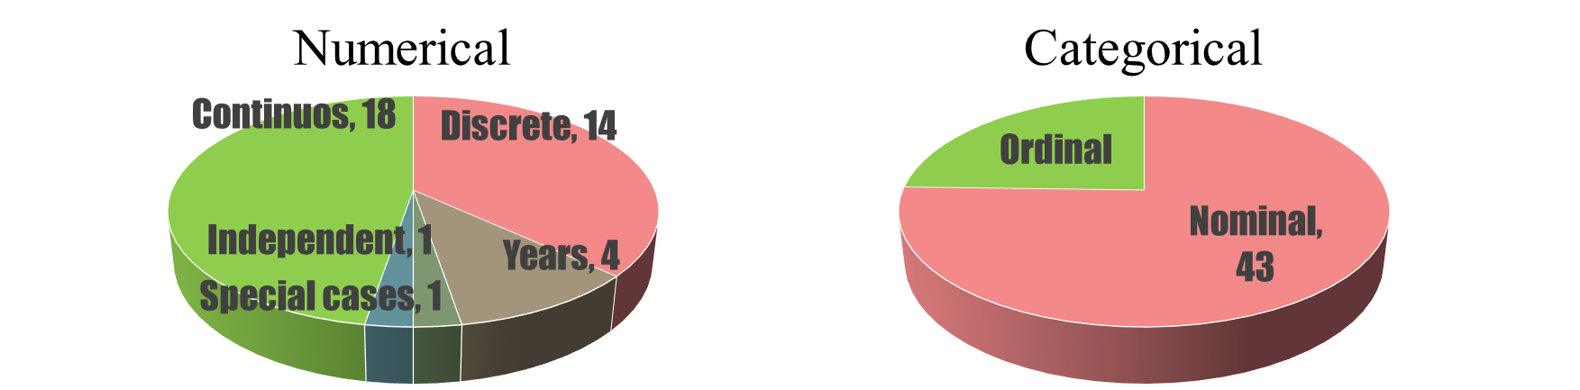
2. DATA ANALYSIS VARIABLE

Slide 10
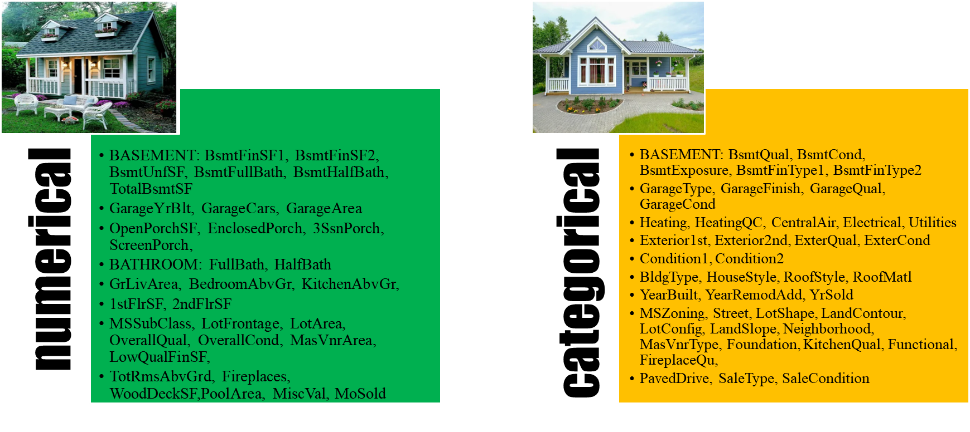
TYPES OF VARIABLES

Slide 11
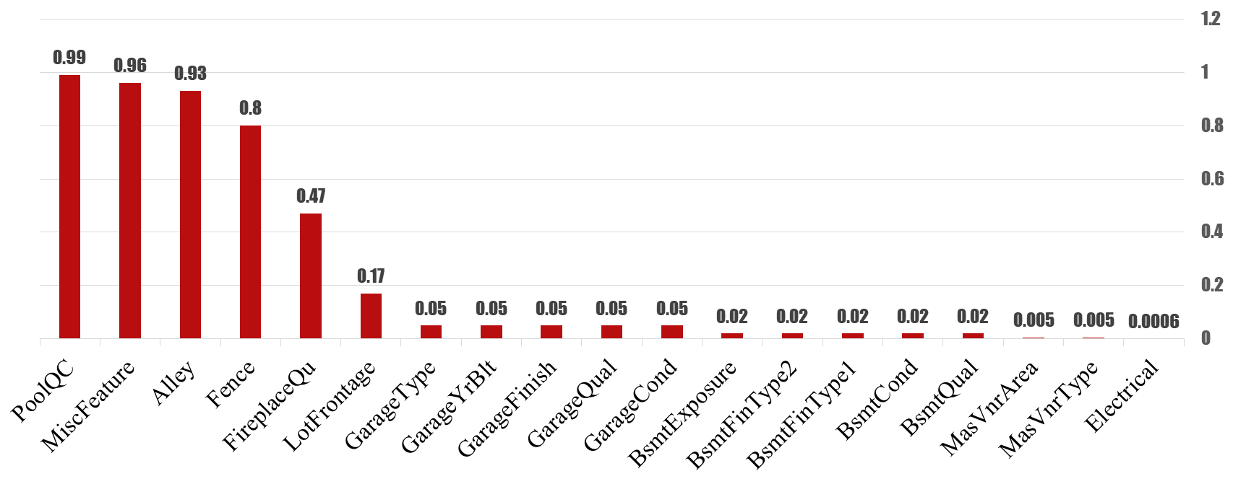
MISSING DATA

Slide 12
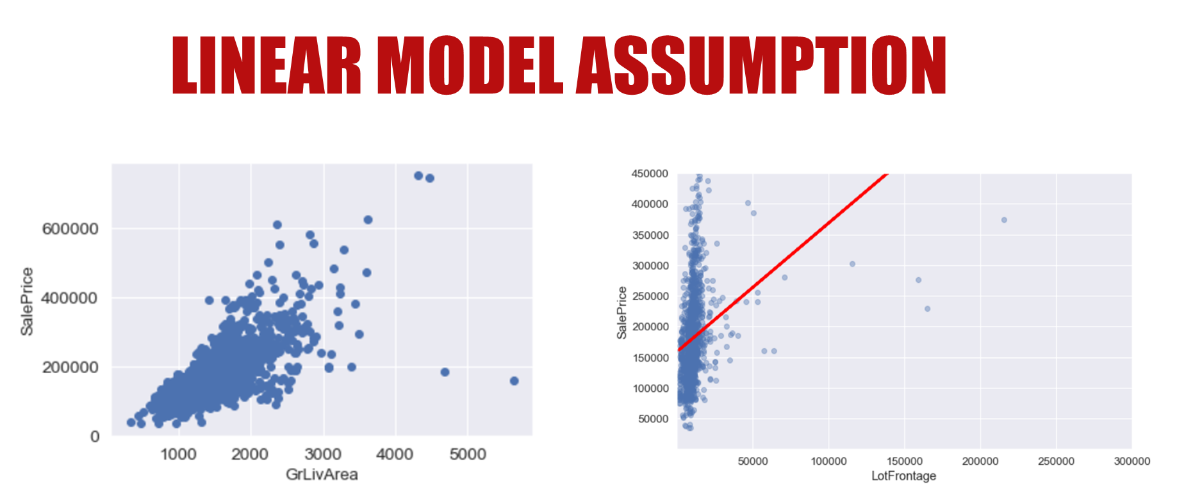

Slide 13
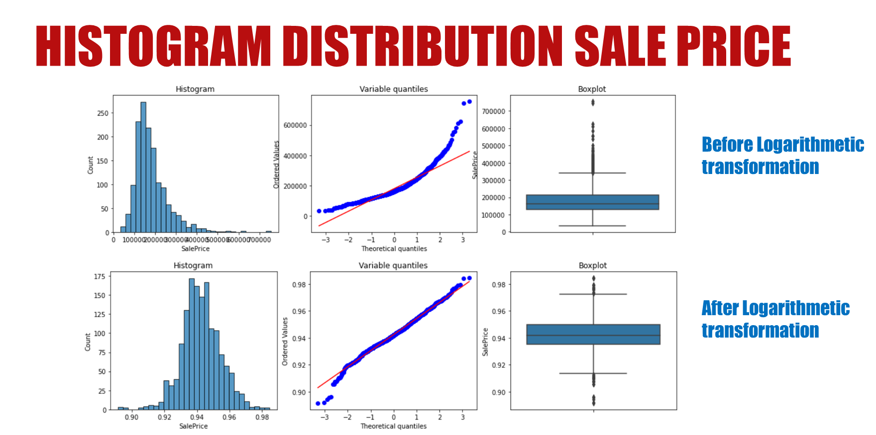

Slide 14
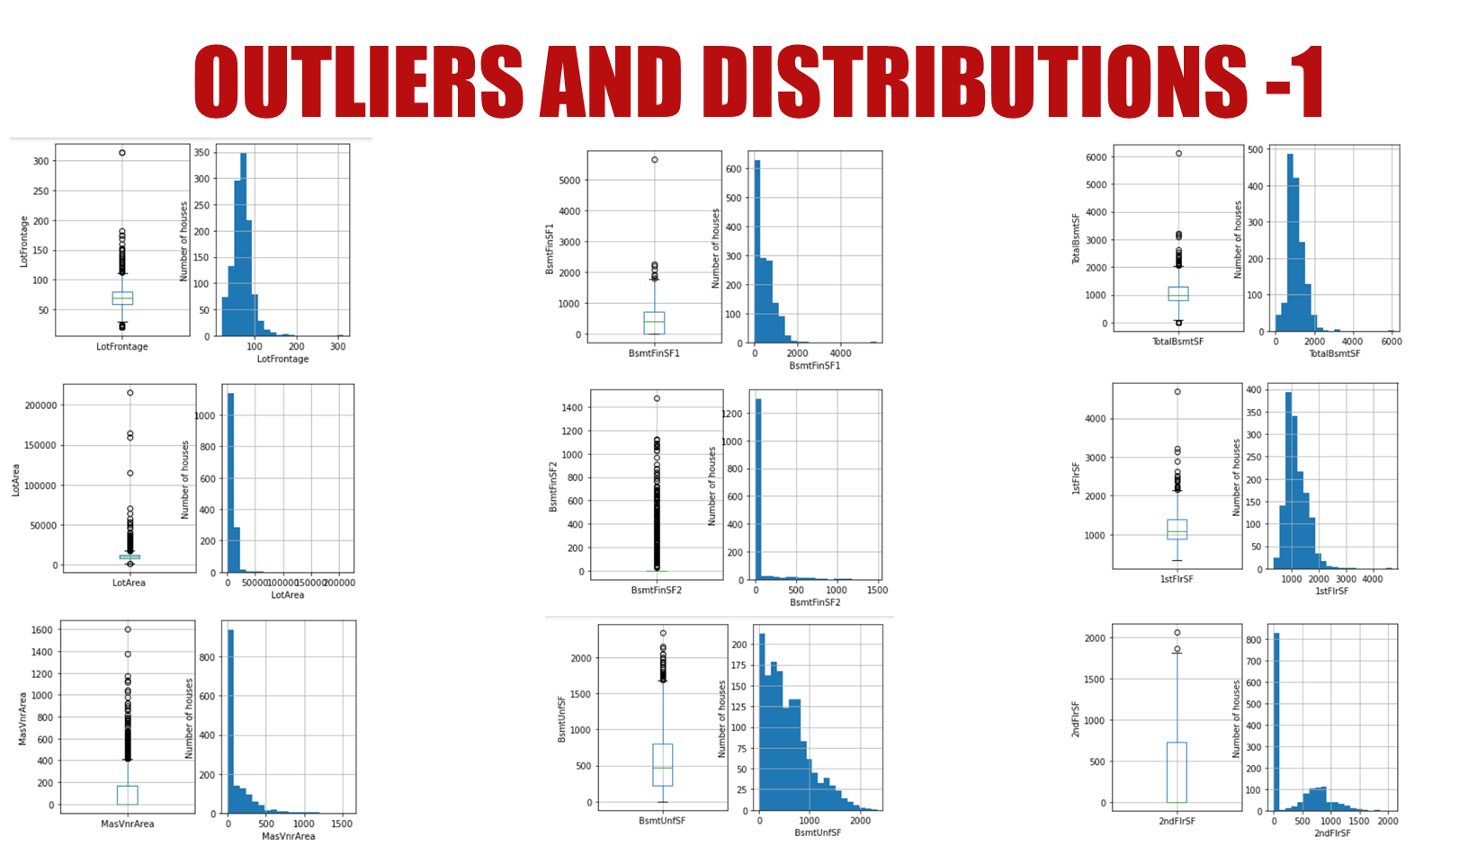

Slide 15
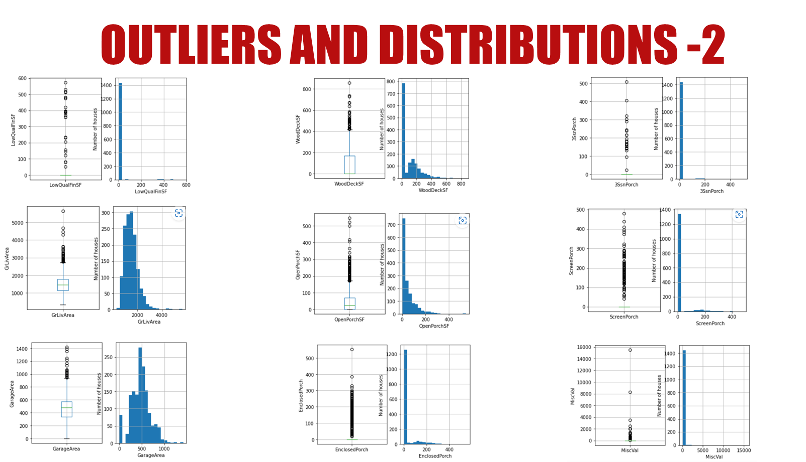

Slide 16
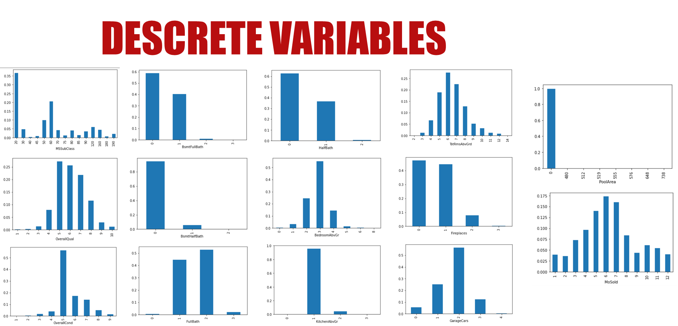

Slide 17
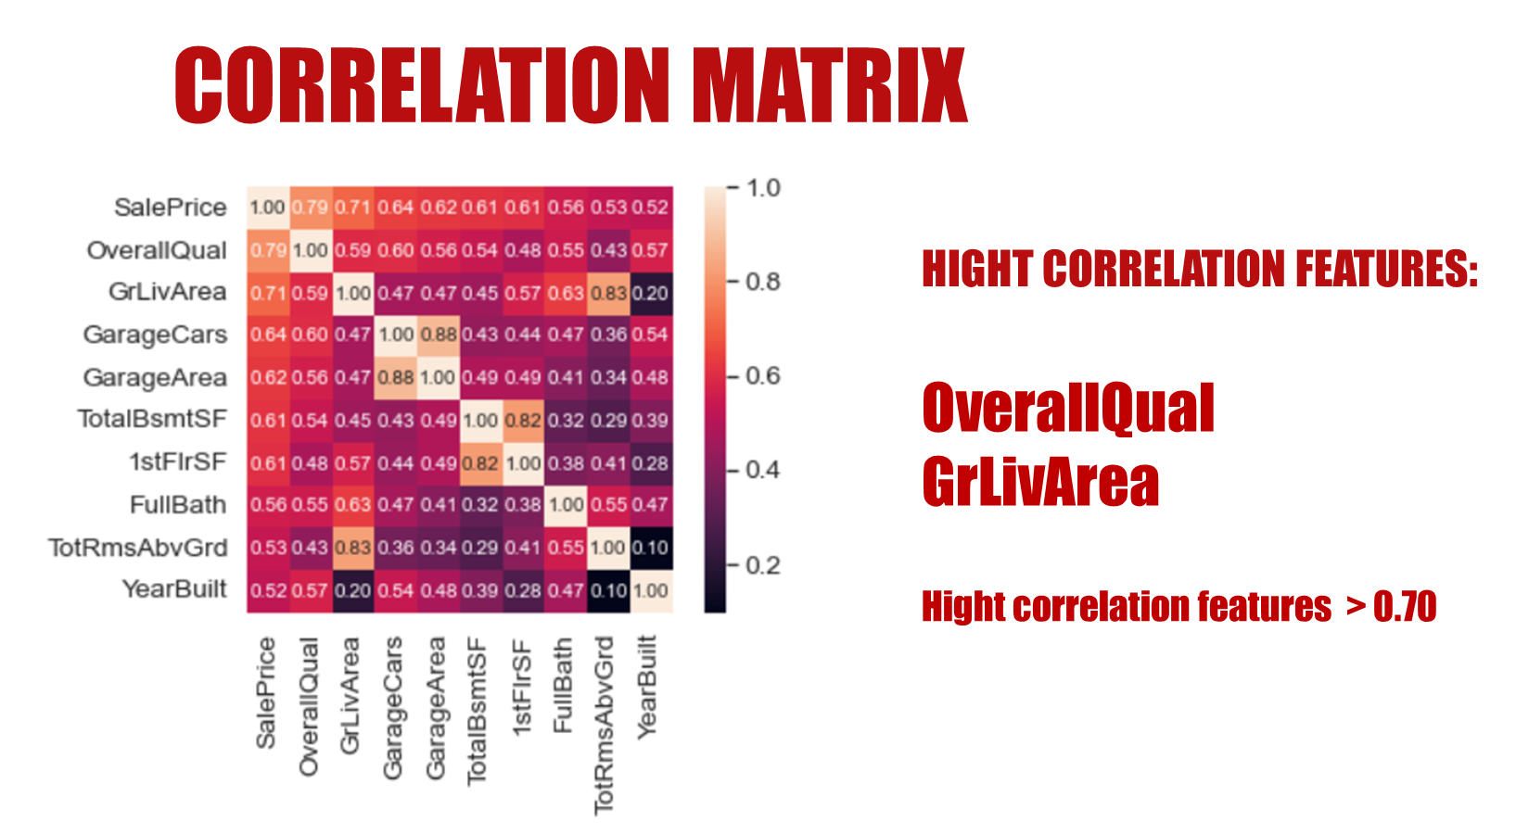

Slide 18
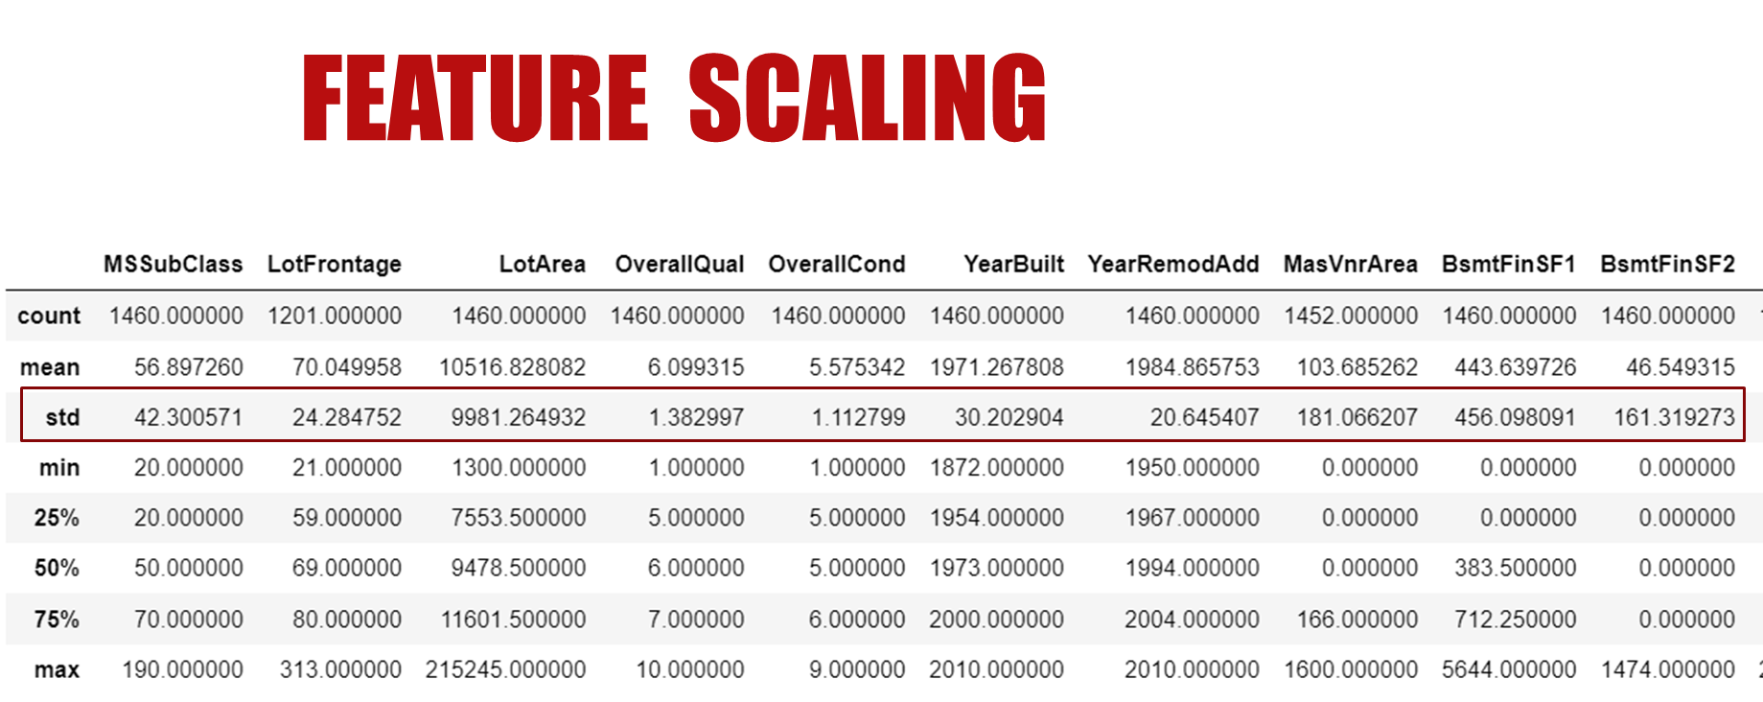

Slide 19
3.MISSING DATA IMPUTATION

Slide 20
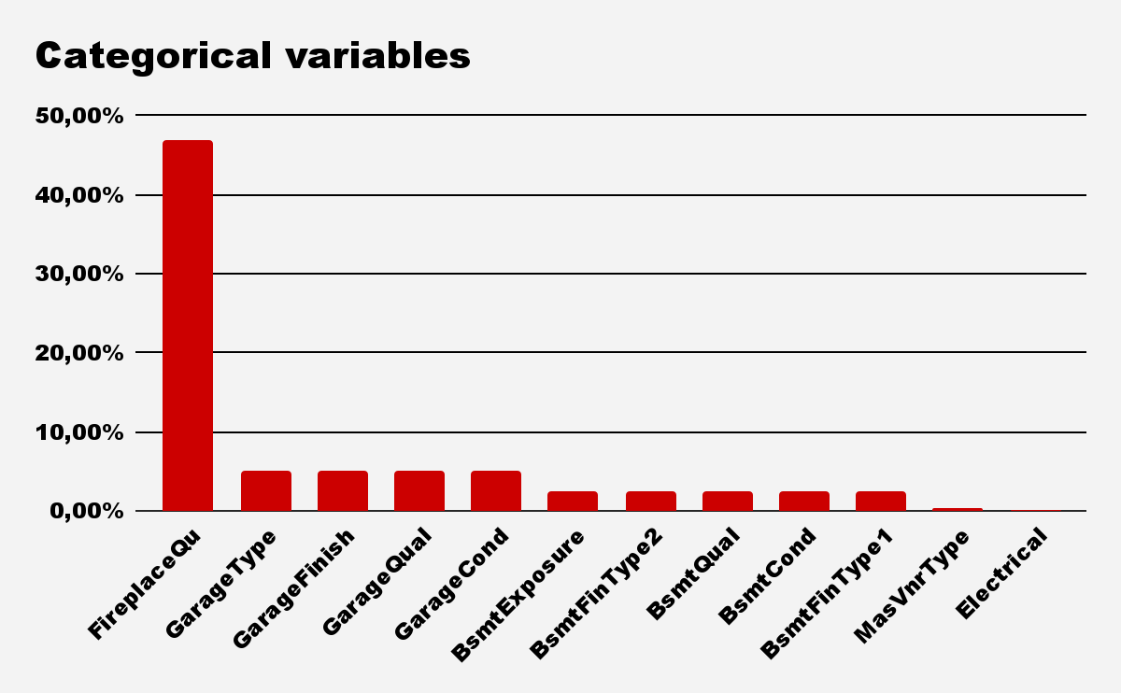
3. Missing Data Imputation

Slide 21
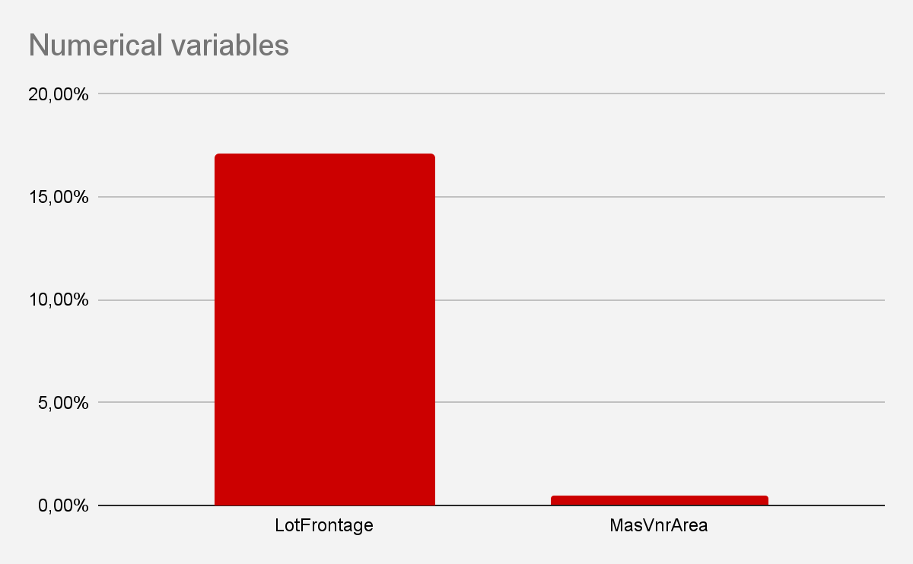
3. Missing Data Imputation

Slide 22
3.Missing Data Imputation
Numerical
Categorical
KNN Imputation
Mean, Median Imputation
Random Sample Imputation
Frequent Category Imputation
Random Sample Imputation

Slide 23
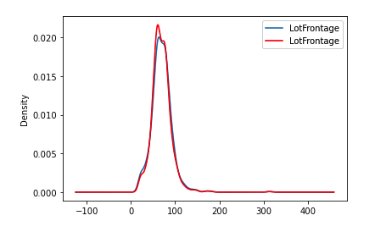
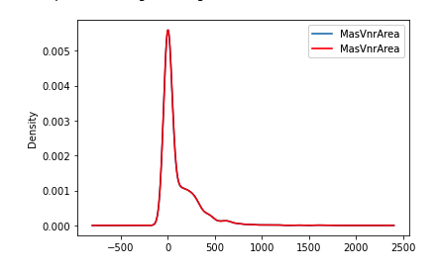
3.Missing Data Imputation
Numerical
KNN IMPUTATION
Distribution before and after imputation

Slide 24
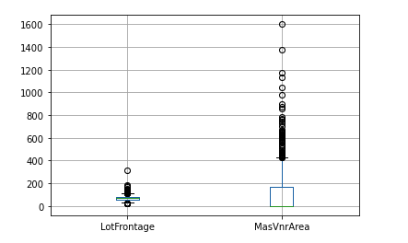
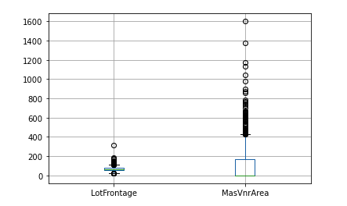
3.Missing Data Imputation
Numerical
KNN IMPUTATION
Before imputation
After imputation

Slide 25
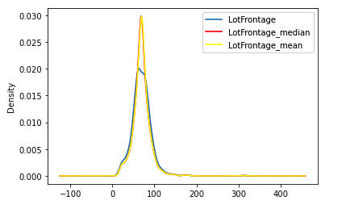
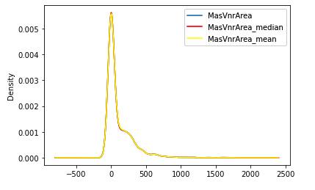
3.Missing Data Imputation
Numerical
MEAN, MEDIAN IMPUTATION

Slide 26
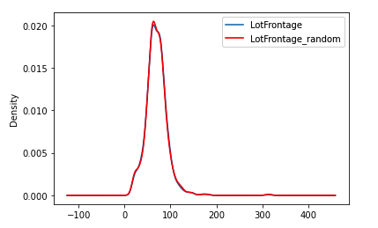
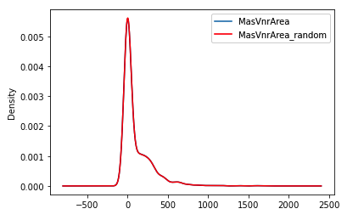
3.Missing Data Imputation
Numerical
RANDOM IMPUTATION

Slide 27
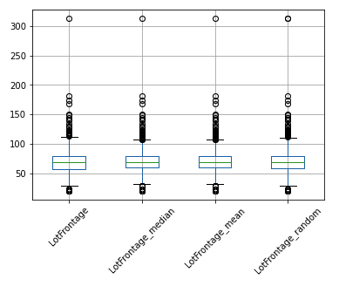
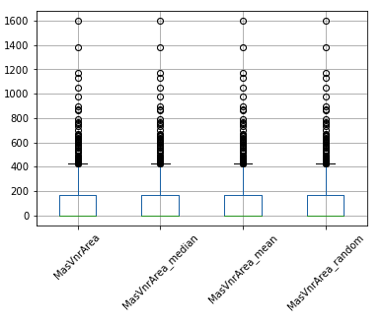
3.Missing Data Imputation
Numerical
Analysis of boxplots before and after imputation

Slide 28
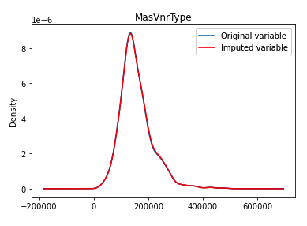
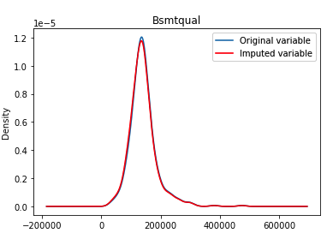
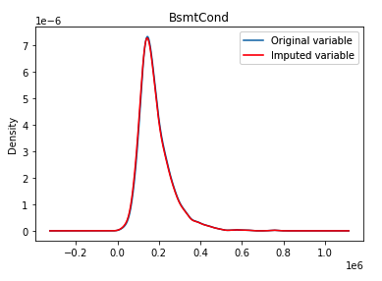
3.Missing Data Imputation
Categories
FREQUENT IMPUTATION

Slide 29
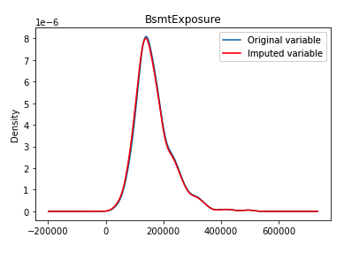
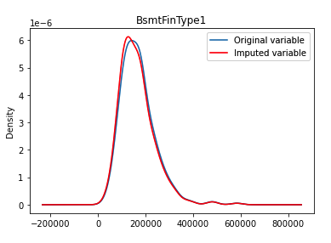
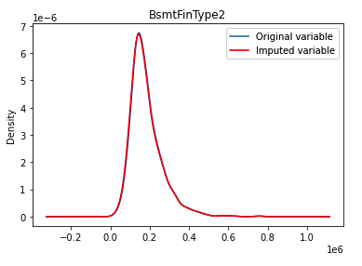
3.Missing Data Imputation
Categories
FREQUENT IMPUTATION

Slide 30
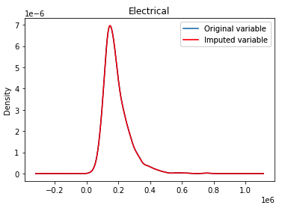
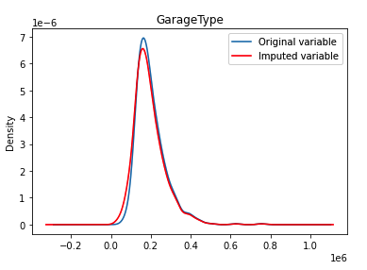
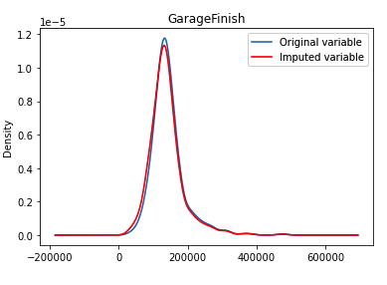
3.Missing Data Imputation
Categories
FREQUENT IMPUTATION

Slide 31
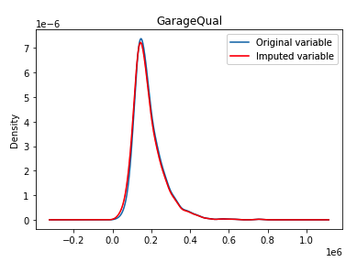
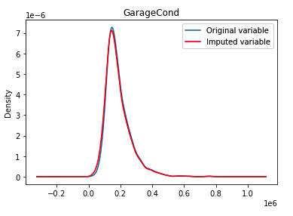
3.Missing Data Imputation
Categories
FREQUENT IMPUTATION

Slide 32
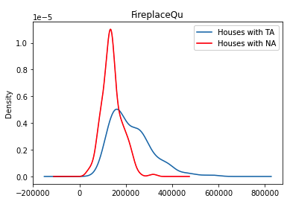
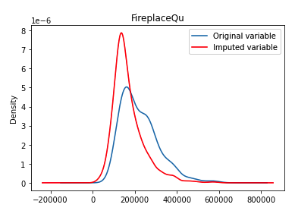
3.Missing Data Imputation
Categories
FREQUENT IMPUTATION

Slide 33
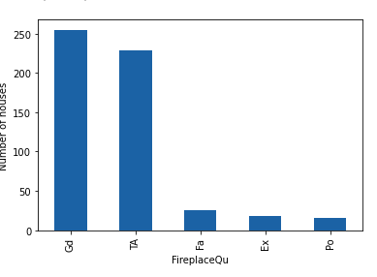
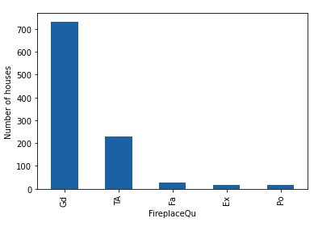
3.Missing Data Imputation
Categories
FREQUENT IMPUTATION
before imputation
after imputation

Slide 34
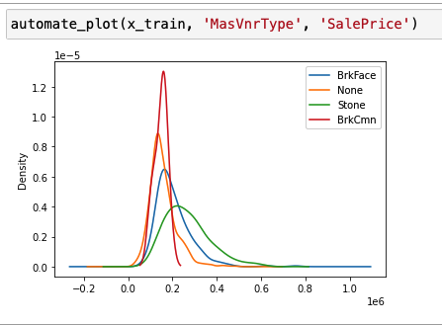
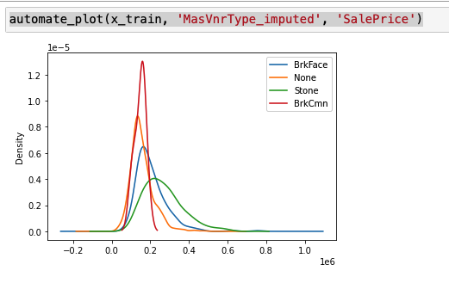
3.Missing Data Imputation
Categories
RANDOM SAMPLE IMPUTATION
before imputation
after imputation

Slide 35
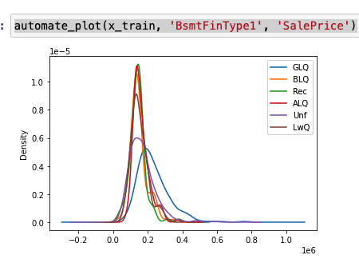
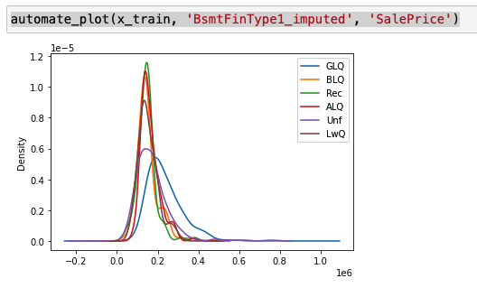
3.Missing Data Imputation
Categories
RANDOM SAMPLE IMPUTATION
before imputation
after imputation

Slide 36
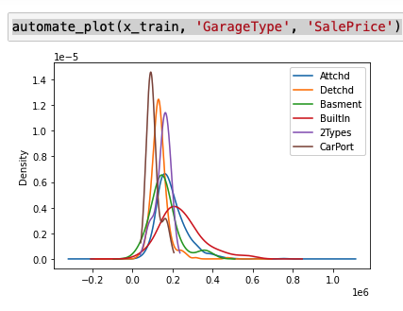
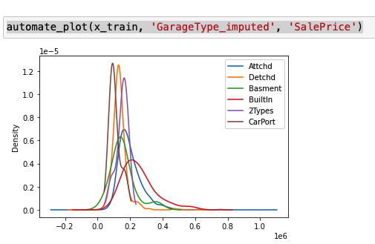
3.Missing Data Imputation
Categories
RANDOM SAMPLE IMPUTATION
before imputation
after imputation

Slide 37
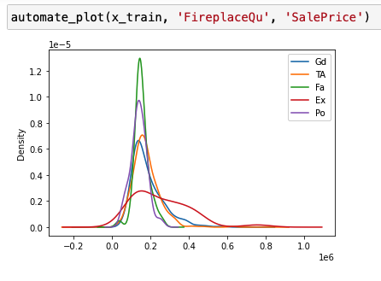

3.Missing Data Imputation
Categories
RANDOM SAMPLE IMPUTATION
before imputation
after imputation

Slide 38

4. DISCRETISATION

Slide 39

5. ENCODING

Slide 40
FEATURE SELECTION
•Constant :
DROP CONSTANT FEATURES
•Duplicated:
DROP DUPLICATED FEATURES
•Correlated:
SMART CORRELATED SELECTION

Slide 41
6.PIPELINE
Pipeline: Imputer_num,
Imputer_cat
Rare_label
Discretiser
Encoder
Scaler
Constant
Duplicated
Correlated
Algorithm
Grid Search:
Imputer_num,
Imputer_cat
Discretiser
Encoder
Algorithm

Slide 42
Modeling Results
Svr grid search best params:
'SVR__gamma': 'scale',
'SVR__kernel': 'poly',
'discretiser__bins': 12, 'encoder__encoding_method': 'ordered', 'imputer_cat__imputation_method': 'missing', 'imputer_num__imputation_method': 'median'
SVR:
SVR Train set: 97 %
SVR Test set: 86 %

Slide 43





THANK YOU !!!!
СПАСИБО ЗА ПРОСМОТР !!!

